Slide 1


Data Analytics and Visualization for Business Impact with Power BI
Raja Sekhar Rapaka

Slide 2
Introduction
This project is part of the PwC Switzerland Power BI in Data Analytics Virtual Case Experience, demonstrating the application of digital tools in data visualization, automation, data cleansing, and more to address common business challenges. It features a series of Power BI dashboards focusing on Call Centre Trends, Customer Retention, and Diversity & Inclusion. Each dashboard provides actionable insights into different facets of business operations and strategic planning, aiding PwC Switzerland and its clients in enhancing operational efficiency, fostering customer loyalty, and promoting a more inclusive workplace.
Through meticulous data analysis and visualization, this project aims to support informed decision-making and highlight areas for improvement and innovation.
Creating comprehensive Power BI dashboards showcasing insights on Call Centre Trends, Customer Retention, and Diversity & Inclusion to drive business impact.
Problem Statement
Project Link : https://github.com/RajasekharRapaka/PwC-Switzerland---Power-BI-Job-Simulation

Slide 3
Task 1
Call Centre Trends
The first dashboard provides a comprehensive view of call center metrics, focusing on customer satisfaction, call volumes, and agent performance. It aids in identifying areas for improvement in call center operations.
Task 2
Customer Retention
This dashboard was developed in response to a request from the telecom's Retention Manager, showcasing key metrics related to customer loyalty and retention. It visualizes data to predict customer churn and identifies potential strategies to enhance customer retention.
Task 3
Diversity & Inclusion
Focusing on the telecom client's goal of improving gender balance at the executive management level, this dashboard visualizes metrics related to diversity and inclusion, offering insights into current trends and areas for action.

Slide 4
Task 1
Call Centre Trends

Slide 5
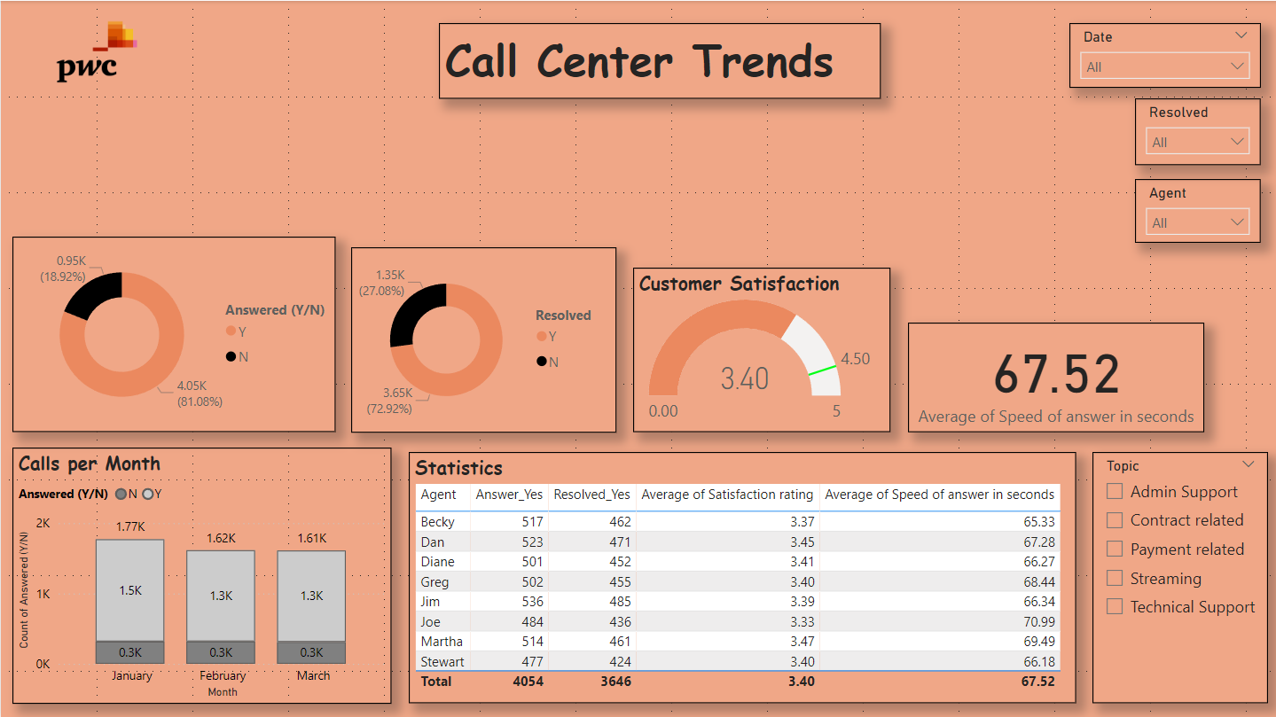

Slide 6
Insights from the Call Center Trends Dashboard
Key Performance Indicators (KPIs)
Customer Satisfaction: The average satisfaction rating is 3.40 out of 5, indicating a generally positive customer experience.
Call Resolution: 67.52% of calls were resolved, suggesting room for improvement in addressing customer inquiries efficiently.
Speed of Answer: The average speed of answer is 67.52 seconds, which could be considered acceptable but may benefit from further optimization.
Agent Performance
Becky, Dan, and Diane: These agents consistently achieved above-average satisfaction ratings and call resolution rates, making them top performers.
Stewart: While Stewart's overall performance is satisfactory, his call resolution rate is slightly lower than the average.
Call Volume and Trends
Monthly Calls: The number of calls received fluctuates slightly month-to-month but remains relatively consistent overall.
January and February: These months experienced slightly higher call volumes, potentially due to seasonal factors or specific events.
Topic Analysis
Contract-Related and Payment-Related Calls: These topics account for a significant portion of the call volume, suggesting a need for clear communication and efficient processes related to contracts and payments.
Technical Support: Technical support calls are also prevalent, indicating the importance of providing effective assistance and troubleshooting.
Recommendations
Improve Call Resolution: Implement strategies to increase call resolution rates, such as providing agents with additional training or resources.
Optimize Speed of Answer: Explore ways to reduce average speed of answer, such as improving call routing or agent efficiency.
Recognize Top Performers: Acknowledge and reward high-performing agents to maintain motivation and encourage best practices.
Address Common Topics: Develop targeted solutions for contract-related and payment-related issues to enhance customer satisfaction and reduce call volume.
Monitor Trends: Continuously track call volume, resolution rates, and satisfaction ratings to identify trends and make data-driven decisions.
By addressing these insights and recommendations, the call center can improve overall performance, enhance customer satisfaction, and optimize operational efficiency.

Slide 7
Task 2
Customer Retention

Slide 8
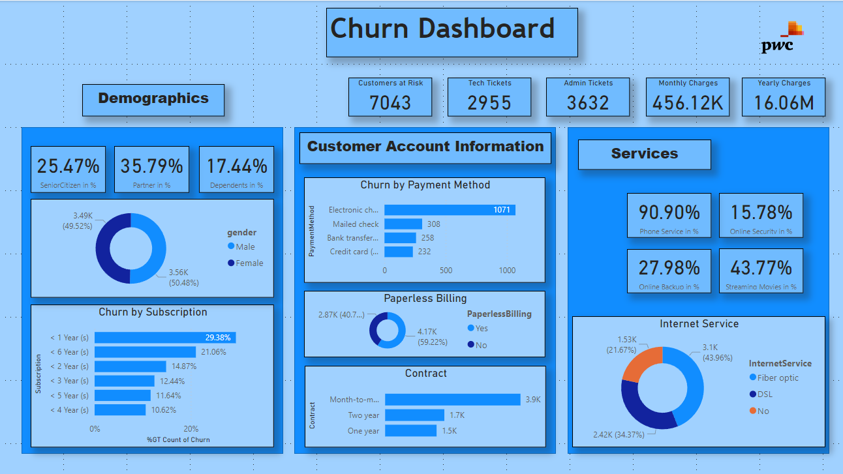

Slide 9
Insights from the Churn Dashboard
Key Metrics
Customers at Risk: 7043 customers are identified as at risk of churn, indicating a need for targeted retention efforts.
Ticket Volumes: The high volume of tech tickets (2955) and admin tickets (3632) suggests potential areas for improvement in customer support and account management.
Revenue: The annual revenue of 16.06 million indicates the financial impact of churn on the business.
Demographic Analysis
Senior Citizens: 25.47% of customers are senior citizens, suggesting a significant portion of the customer base may have specific needs or preferences.
Partners: 35.79% of customers are partners, indicating a potential opportunity to leverage relationship marketing or bundled offerings.
Dependents: 17.44% of customers have dependents, suggesting a need to consider family-oriented plans or benefits.
Customer Account Information
Payment Method: Electronic check is the most common payment method (90.90%), followed by mailed check and credit card.
Paperless Billing: 4.17% of customers have opted for paperless billing, indicating a growing preference for digital communication.
Internet Service: 64.37% of customers subscribe to fiber optic internet, followed by DSL.
Churn Analysis
Churn by Payment Method: Electronic check customers have the highest churn rate (15.78%), suggesting potential issues with this payment method.
Churn by Subscription: Customers with shorter subscription terms (less than 1 year) have higher churn rates, indicating a need to focus on customer retention efforts for new subscribers.
Churn by Contract: Month-to-month customers have the highest churn rate (29.38%), emphasizing the importance of longer-term contracts for customer retention.
Recommendations
Targeted Retention: Implement targeted retention campaigns for customers at risk, considering their demographics, payment methods, and subscription terms.
Improve Support: Enhance customer support processes to address tech and admin tickets more efficiently and effectively.
Offer Bundled Plans: Explore opportunities to offer bundled plans or services to partners and families to increase customer value and reduce churn.
Promote Paperless Billing: Encourage more customers to adopt paperless billing to reduce costs and improve communication.
Review Payment Methods: Evaluate the performance of different payment methods and address any issues contributing to higher churn rates.
Consider Contract Incentives: Offer incentives or benefits for customers who sign longer-term contracts to encourage loyalty and reduce churn.
By addressing these insights and recommendations, the company can improve customer retention, reduce churn, and enhance overall business performance.

Slide 10
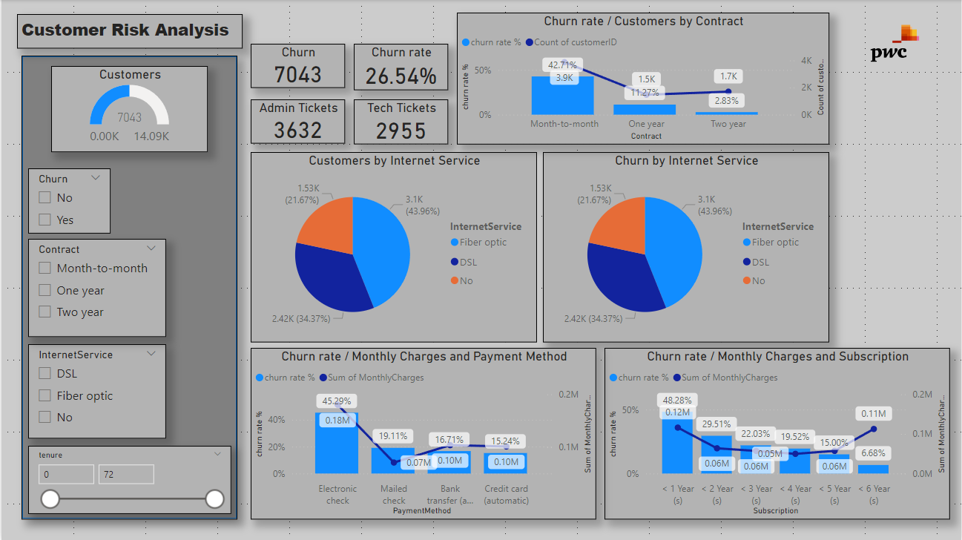

Slide 11
Insights from the Customer Risk Analysis Dashboard
Key Metrics
Customers at Risk: 7043 customers are identified as at risk of churn, indicating a need for targeted retention efforts.
Ticket Volumes: The high volume of admin tickets (3632) and tech tickets (2955) suggests potential areas for improvement in customer support and account management.
Customer Segmentation
Contract Type: Month-to-month customers have the highest churn rate, followed by one-year and two-year contracts.
Internet Service: Customers with DSL have the highest churn rate, while fiber optic customers have the lowest.
Payment Method: Electronic check customers have a higher churn rate compared to other payment methods.
Churn Rate Analysis
Churn by Contract: Month-to-month customers have a significantly higher churn rate than those with longer-term contracts, highlighting the importance of contract length for retention.
Churn by Internet Service: Customers with DSL internet service have a higher churn rate than those with fiber optic or no internet service.
Churn by Monthly Charges: Customers with lower monthly charges have a higher churn rate, suggesting a correlation between pricing and customer loyalty.
Recommendations
Targeted Retention: Implement targeted retention campaigns for customers at risk, focusing on contract type, internet service, and payment method.
Improve Support: Enhance customer support processes to address admin and tech tickets more efficiently and effectively.
Offer Longer-Term Contracts: Encourage customers to sign longer-term contracts to reduce churn and increase customer lifetime value.
Upgrade Internet Service: Promote upgrades to fiber optic internet to improve customer satisfaction and potentially reduce churn.
Review Payment Methods: Evaluate the performance of different payment methods and address any issues contributing to higher churn rates.
By addressing these insights and recommendations, the company can improve customer retention, reduce churn, and enhance overall business performance.

Slide 12
Task 3
Diversity & Inclusion

Slide 13
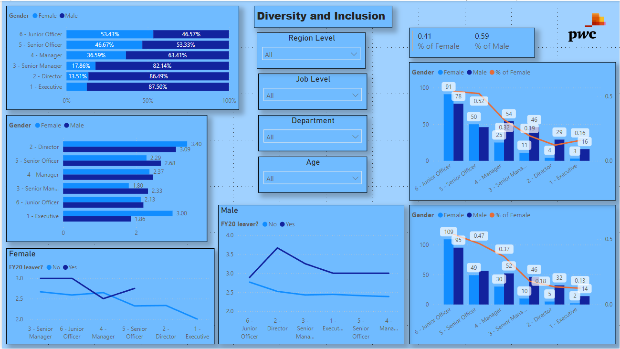

Slide 14
Insights from the Diversity and Inclusion Dashboard
Key Metrics
Gender Diversity: The overall gender diversity is balanced, with approximately 50% female and 50% male employees.
Regional Diversity: The region level data indicates a slight imbalance in gender distribution, with a higher percentage of females in some regions compared to others.
Job Level Diversity: While there is a relatively balanced gender distribution at lower job levels, females are underrepresented in higher-level positions, particularly director and executive roles.
Demographic Analysis
Gender by Job Level: Female representation decreases as job level increases, suggesting a potential gender gap in career progression.
Gender by Department: Some departments have a more balanced gender distribution than others, indicating a need for targeted initiatives to address gender disparities.
Age and Gender: The age distribution varies by gender, with a higher concentration of females in certain age groups.
Churn Analysis
FY20 Leavers: The churn rate is slightly higher for females compared to males, suggesting potential factors contributing to female attrition.
Churn by Job Level: Leavers are more likely to be from lower-level positions, indicating a need to address factors impacting employee retention at these levels.
Recommendations
Career Development: Implement programs and initiatives to support female employees in career advancement and leadership development.
Mentorship Programs: Establish mentorship programs to connect female employees with senior leaders and provide guidance and support.
Flexible Work Arrangements: Offer flexible work arrangements to accommodate the needs of female employees, particularly those with family responsibilities.
Diversity Training: Conduct diversity and inclusion training to raise awareness of unconscious bias and promote a more inclusive workplace culture.
Retention Strategies: Develop targeted retention strategies for female employees, addressing factors contributing to higher churn rates.
By addressing these insights and recommendations, the company can create a more inclusive and equitable workplace, fostering diversity and promoting gender equality.

Slide 15
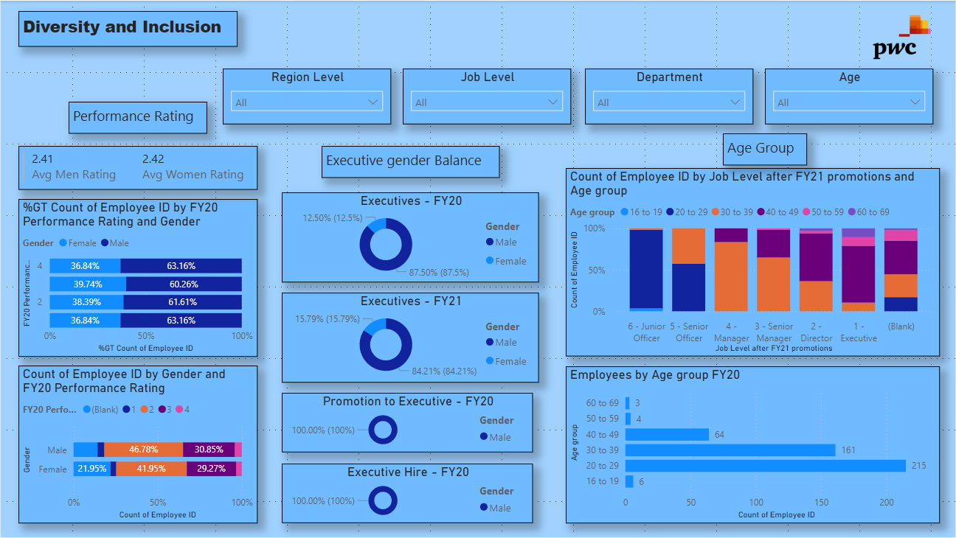

Slide 16
Insights from the Diversity and Inclusion Dashboard
Key Metrics
Gender Diversity: The overall gender diversity is balanced, with approximately 50% female and 50% male employees.
Performance Rating: There is a slight difference in average performance ratings between male and female employees, with male employees having a slightly higher average.
Executive Representation: The executive gender balance data shows a higher percentage of male executives compared to female executives.
Demographic Analysis
Gender by Job Level: Female representation decreases as job level increases, suggesting a potential gender gap in career progression.
Age Group: The age distribution varies by gender, with a higher concentration of females in certain age groups.
Performance Rating by Gender: While there is a slight difference in average performance ratings, female employees are represented across all performance levels, indicating strong performance from both genders.
Churn Analysis
FY20 Performance Rating: Female employees are more likely to leave with a performance rating of "Good" or "Excellent," suggesting potential factors impacting retention at these performance levels.
FY20 Performance Rating by Gender: The distribution of performance ratings differs slightly by gender, with male employees more likely to have "Outstanding" or "Needs Improvement" ratings.
Recommendations
Career Development: Implement programs and initiatives to support female employees in career advancement and leadership development.
Mentorship Programs: Establish mentorship programs to connect female employees with senior leaders and provide guidance and support.
Flexible Work Arrangements: Offer flexible work arrangements to accommodate the needs of female employees, particularly those with family responsibilities.
Diversity Training: Conduct diversity and inclusion training to raise awareness of unconscious bias and promote a more inclusive workplace culture.
Retention Strategies: Develop targeted retention strategies for female employees, addressing factors contributing to higher churn rates, especially for those with high performance ratings.
By addressing these insights and recommendations, the company can create a more inclusive and equitable workplace, fostering diversity and promoting gender equality.

Slide 17
Thank You

